Slide 1

Week 03 The Research Process - The Broad Problem Area and Defining the Problem Statement
Masters of Information Systems & Technology
MIS 6220 RESEARCH METHODS
_{BY}
Prof. Jimmy K.N.Macharia,
Associate Professor of Information Systems &Technology, and
Dean, School of Science & Technology,
_{kmacharia@usiu.ac.ke}

Slide 2
Overview
First Review of the Literature
Reasons for reviewing the literature
Preliminary Information Gathering
Data Sources
The literature review process
Problem statement formulation:
A good problem statement
Research Proposal contains

Slide 3
1.1 Reasons for reviewing the literature
To conduct a ‘preliminary’ search of existing material
To organise valuable ideas and findings
To identify other research that may be in progress
To generate research ideas
To develop a critical perspective

Slide 4
Literature Review
A good literature survey:
Ensures that important variables are not left out of the study.
Helps the development of the theoretical framework and hypotheses for testing.
Ensures that the problem statement is precise and clear.
Enhances testability and replicability of the findings.
Reduces the risk of “reinventing the wheel”.
Confirms that the problem is perceived as relevant and significant.

Slide 5
Data sources
Textbooks
Academic and professional journals
Theses
Conference proceedings
Unpublished manuscripts
Reports of government departments and corporations
Newspapers
The Internet

Slide 6
Searching for Literature
Nature of information to be gathered:
Background information of the organization.
Prevailing knowledge on the topic.
Most libraries have the following electronic resources at their disposal:
Electronic journals
Full-text databases
Bibliographic databases
Abstract databases

Slide 7
1.2 First Review of the Literature
Helps the researcher to:
Structure research on work already done
Develop problem statement with precision and clarity
Is beneficial in both basic and applied research projects

Slide 8
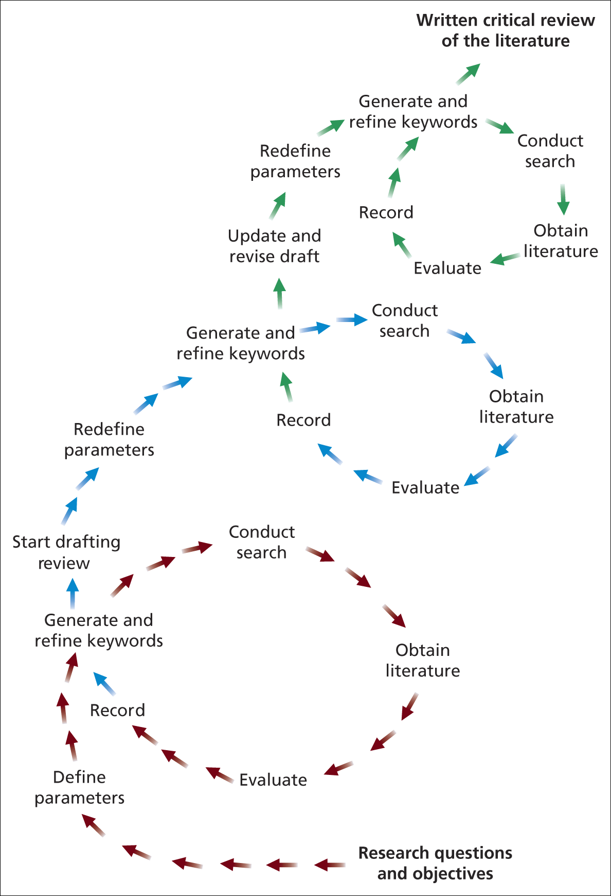
1.3 The literature review process
Source: Saunders et al. (2003)
Figure 3.1 The literature review process

Slide 9
1.4 The Critical Review (1)
Approaches used
Deductive – Develops a conceptual framework from the literature which is then tested using the data
Inductive -
Explores the data to develop theories which are then tested against the literature

Slide 10
1.5 The Critical Review (2)
Key purposes
To further refine research questions and objectives
To discover recommendations for further research
To avoid repeating work already undertaken
To provide insights into strategies and techniques appropriate to your research objectives
Based on Gall et al. (2006)

Slide 11
1.6 Adopting a critical perspective (1)
Skills for effective reading
Previewing
which is looking around the text before you start reading in order to establish precisely its purpose and how it may inform you literature search
Annotating
that is conducting a dialogue with yourself, the author and the issues and the ideas at stake
Summarising
the best way to determine that you’ve really got the point is to be able to state it in your words. Outlining the argument of text is a version of annotating, and can be done quite informally in the margins of the text
Comparing and contrasting:
ask your self how your thinking has been altered by this reading or how has it affected your response to the issue and themes your research
Harvard College Library (2006)

Slide 12
1.7 Adopting a critical perspective (2)
The most important skills are
The capacity to evaluate what you read
The capacity to relate what you read to other information
Wallace and Wray (2006)

Slide 13
2. Remember: The big Picture-The Journey ..
Stages in the Research Process (Researchers Perspective)
Formulate Problem
Determine Research Design
Design Data Collection
Method and Forms
Design Sample and Collect Data
Analyze and Interpret the Data
Prepare the Research Report

Slide 14
2.1 A good problem statement
Research objective: why of the research
Research objective applied research:
to solve a specific problem in a work setting;
to change something.
Example:
To determine factors that increase employee commitment to the organization;
Allows manager to increase commitment and hence to decrease turnover, absenteeism and increase performance levels.

Slide 15
2.2 Problem Statement: Example
The purpose of this study is twofold:
To identify the factors that influence the passenger’s waiting experience and
To investigate the possible impact of waiting on customer satisfaction and service evaluations.

Slide 16
2.3 A good problem statement
Research questions:
what of the research (what do you want to learn?)
Translates problem into a specific need for information
Research questions:
Are related to the objective
If objective is unclear we will not be able to formulate research questions
Example: Research Questions
What are the factors that affect the perceived waiting experience of airline passengers
To what extent do these factors affect the perception of waiting times?
What are the affective consequences of waiting
How does affect mediate the relationship between waiting and service evaluations?
How do situational variables (such as filled time) influence customer reactions to the waiting experience?

Slide 17
Problem Formulation
A well-defined study begins with a clearly defined problem
“The formulation of a problem is often more essential than its solution” - Albert Einstein

Slide 18
Problem Formulation
Slight variations in research questions can lead to substantial differences in later stages the research process (so be careful)
Problem formulation drives decisions related to….
Research design
Is exploratory research needed?
Survey or experiment?
Measurement
Study measures flow directly out of problem statement and research objectives
Sampling
Can we obtain the sample necessary to answer the research questions
Availability? Cost?

Slide 19
Problem Formulation
This “first step” in the research process includes
Defining the problem
Developing research objectives
Developing hypotheses
Most important part of the research process
But also one of the most difficult
Problem is rarely “clear cut”

Slide 20
Problem Formulation
Differentiate between a decision problem and a research problem
Try to get beyond an “info request”
Decision Problems | Research Problems
Develop package for a new product | Evaluate alternative package designs
Increase store traffic | Measure current image of the store
Increase market penetration through the opening of new stores | Evaluate prospective locations
Decide which merchandise will be available for purchase over the Internet | Determine consumers’ confidence in purchasing different categories of products unseen

Slide 21
Problem Formulation
First step is to invest in understanding the decision context
Time investment is significant if the research topic is outside the researchers area of expertise
Eg, nontraditional conjoint study on the impact of social media on investment manager decisions
Understand what is known and what is not
In depth discussions with decision makers
Exploratory research
Lit reviews
IDIs, focus groups, etc. with experts in the field
It is imperative to know what has been studied in order to advance knowledge in the area
Find a “gap” in understanding

Slide 22
The Research Problem
Try to develop a concise “statement” that clearly states the problem to be addressed by the research
“Justification” for the research
This should be the specific research problem that the research will address
Not a “problematic situation” or broader problem area (eg, customer retention, decreasing market share)
Usually an iterative process with the client or decision maker

Slide 23
The Research Problem
If possible, include…
What knowledge is needed
Who needs it
How it will be useful to make a decision
Veterinarians’ disposition toward the state of the profession is not well understood. Furthermore, while significant efforts are underway by the profession (ie, AVMA, AAHA) to support the industry, it is unclear how veterinarians are responding to these efforts. An understanding of how veterinarians view industry trends and the potential solutions (at both the profession and individual veterinarian levels) to adverse industry trends will help the PHP board develop initiatives to ensure the long term sustainability of the profession.

Slide 24
Research Objectives
Once you understand what is known and what is not known, determine what can be answered through primary research
Avoid trying to answer too many questions in one study
Lots of questions require multiple studies or complex designs
Prioritize questions as “primary” and “secondary”
Try to stick to 1-2 primary questions and never compromise the primary questions

Slide 25
Good problem statement: FINER Criteria
Feasibility
Do you have the capability (skills/funds) to answer the question?
Is the proposed sample of interest accessible?
Can the research be conducted in a reasonable timeframe?
Interesting
Are the results going to excite the decision maker?
Novel
Will the results tell the decision maker something new?
Ethical
Institutional review board
Not as relevant for social science studies
Relevant
Be sure to note the expected outcomes of the research
Will results lead to a decision
Strive for “actionable” research

Slide 26
Problem Formulation Exercise
Form research teams of 3-4
I am your client and will present you with a proposal
Your task is to….
Formulate a research problem
Formulate research questions

Slide 27
The “Issue”
My organization represents 80%+ of the food manufacturers in the US
We are worried that the FDA is going to regulate Front-of-Package nutrition information disclosures
We have developed our own FOP initiative that we will roll out over the next 12 months

Slide 28
The “Issue”
We need some “ammunition” to use to demonstrate our FOP initiative is the best
We expect FDA to be skeptical of this industry-sponsored initiative
We expect public health special interest groups to scrutinize our approach
We need solid research to support our initiative

Slide 29
Problem Formulation Exercise
Take 5 minutes to discuss and generate any clarification or probing questions for the client (ie, me)
We’ll have a 10 minute general Q&A session
Then, generate a your research problem statement and specific research objectives

Slide 30
TEAM ASSIGNMENT #1
Discuss some issues that you deal with at your workplace that can be answered with primary research
Discuss the issue broadly (i.e., provide some context)
Develop a problem statement
Develop several clear, concise research questions
Discuss the decisions that would be made depending on the different outcomes of the research

Slide 31
Hints….
Try to acutely identify the problem at hand (and avoid “nice to know” questions)
What information is necessary in order to make a decision?
Think about what course(s) of action will result from your findings
If we find A, what will you do?
What about if we find B?
Make all alternative courses of action explicit
Refer to Beal (Chapter 2)

Slide 32
4.0 The research proposal
Get the MIST Research Guide

Slide 33


